Slide 1
Airline Analysis 2023

Slide 2
Introduction
1

Slide 3
Findings
2

Slide 4
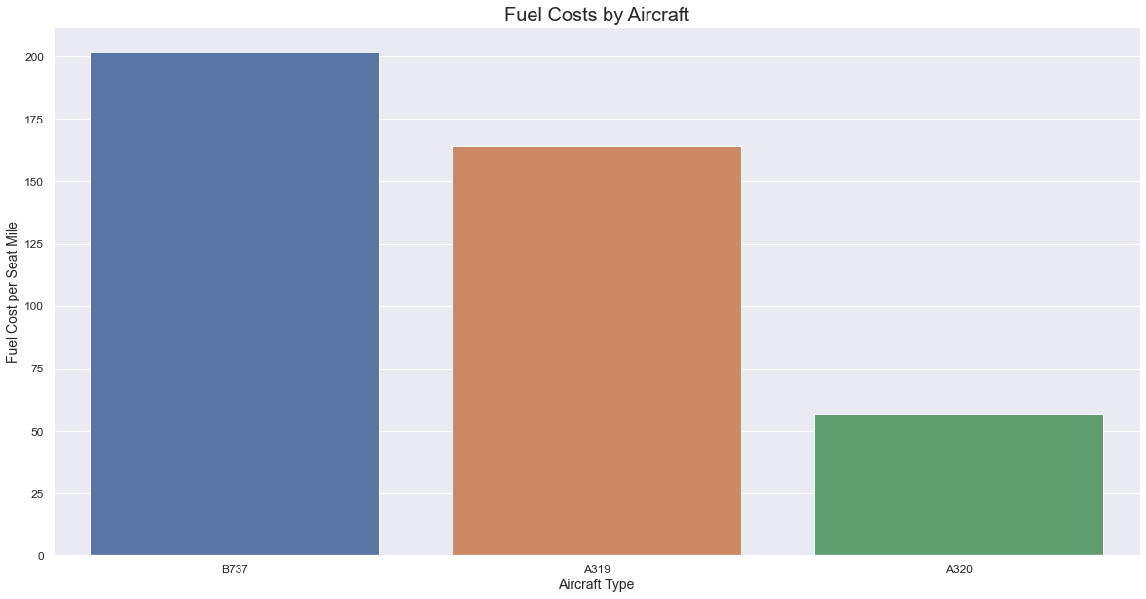
Fuel Costs
Findings 1
A320 aircraft model saves fuel by 4 times.

Slide 5
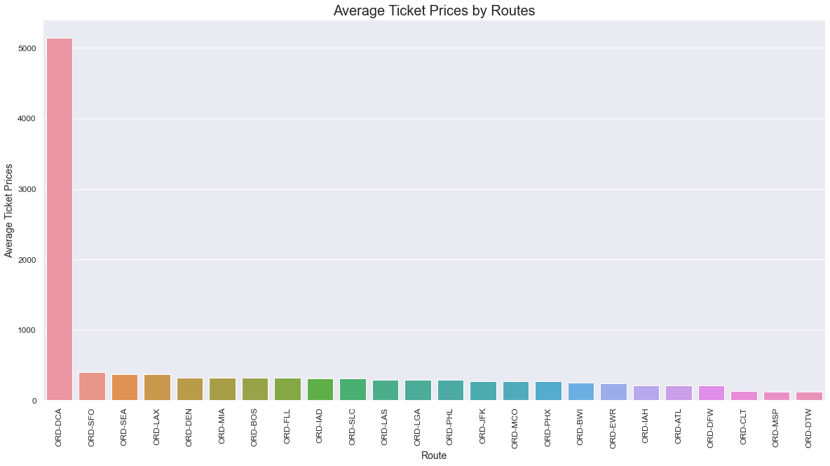
Average Ticket Prices
Findings 2
ORD-DCA has highest ticket prices and need further probe.
Lowest three : ORD-CLT/ORD-MSP/ORD-DTW

Slide 6
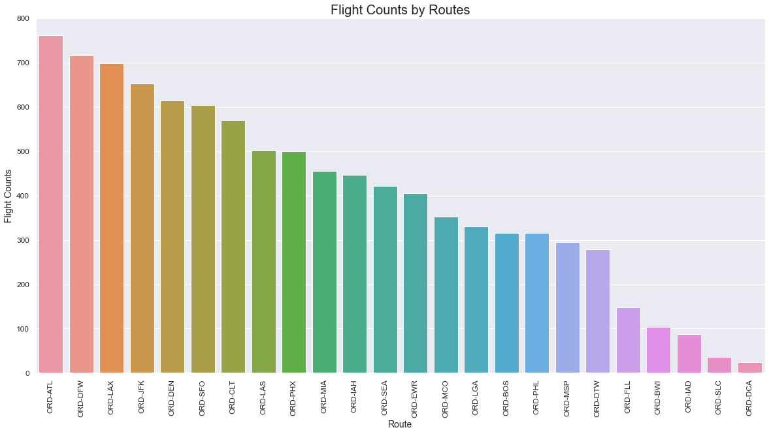
Flight Counts by Routes
Findings 3
ORD-ATL has highest flight counts.
Eliminate lowest five flight counts.

Slide 7
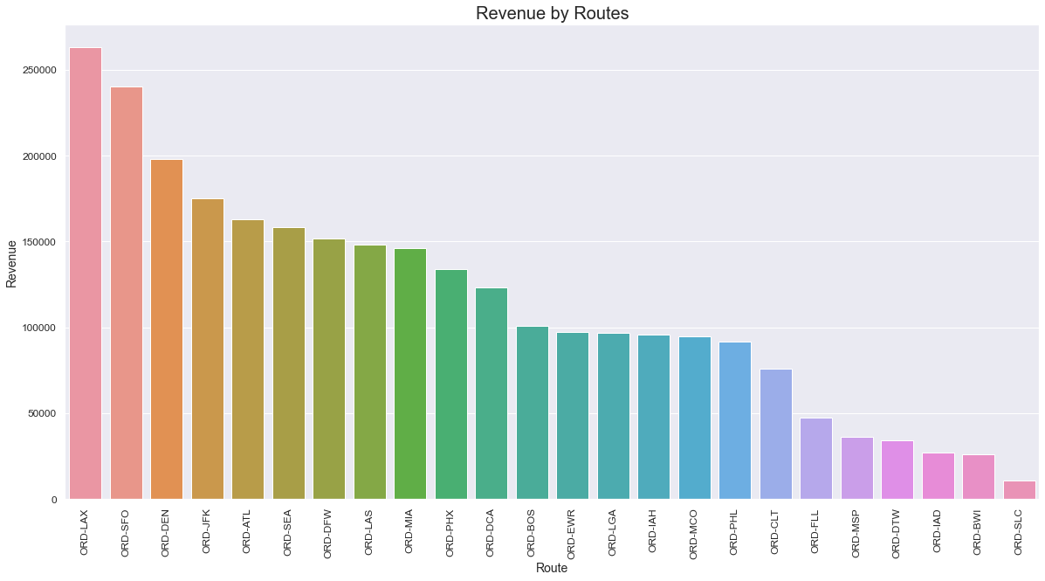
Revenue by Routes
Findings 4
ORD-LAX has highest flight counts.
Trim or set the minimum revenues

Slide 8
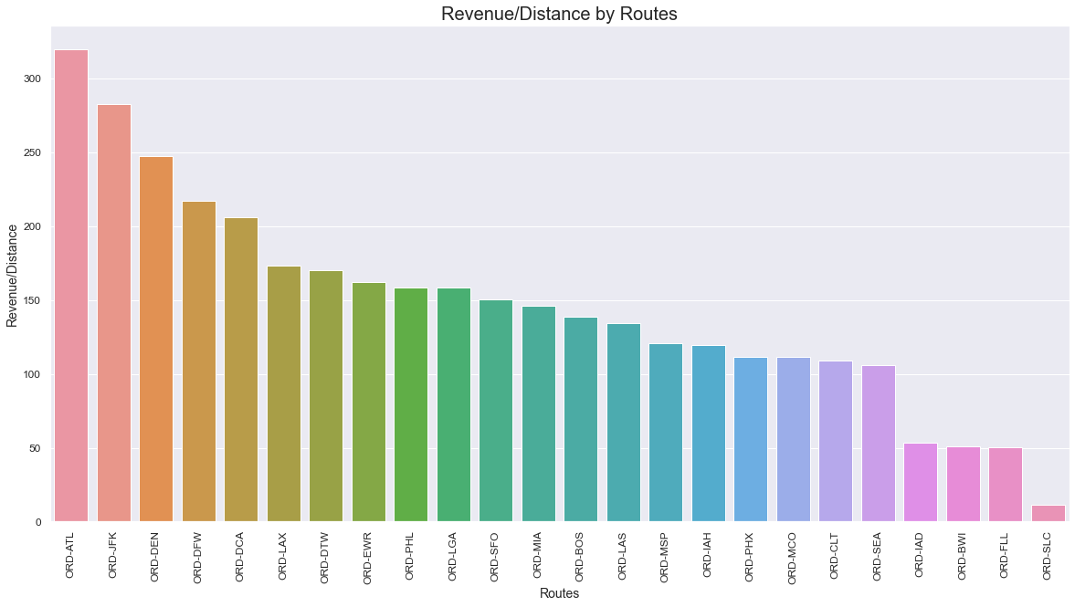
Revenue per Distance by Routes
Findings 5
ORD-ATL gives highest revenue per distance earnings
Examine new possibilities

Slide 9
Recommendations
3

Slide 10
Questions / Issues to ponder
How to manage fuel costs in long term
Competitive Ticket prices
Revenues and future potentials

Slide 11
Thanks!
Any questions ?
You can find me at
@eriksensousa
erik@mail.me

